Slide 1
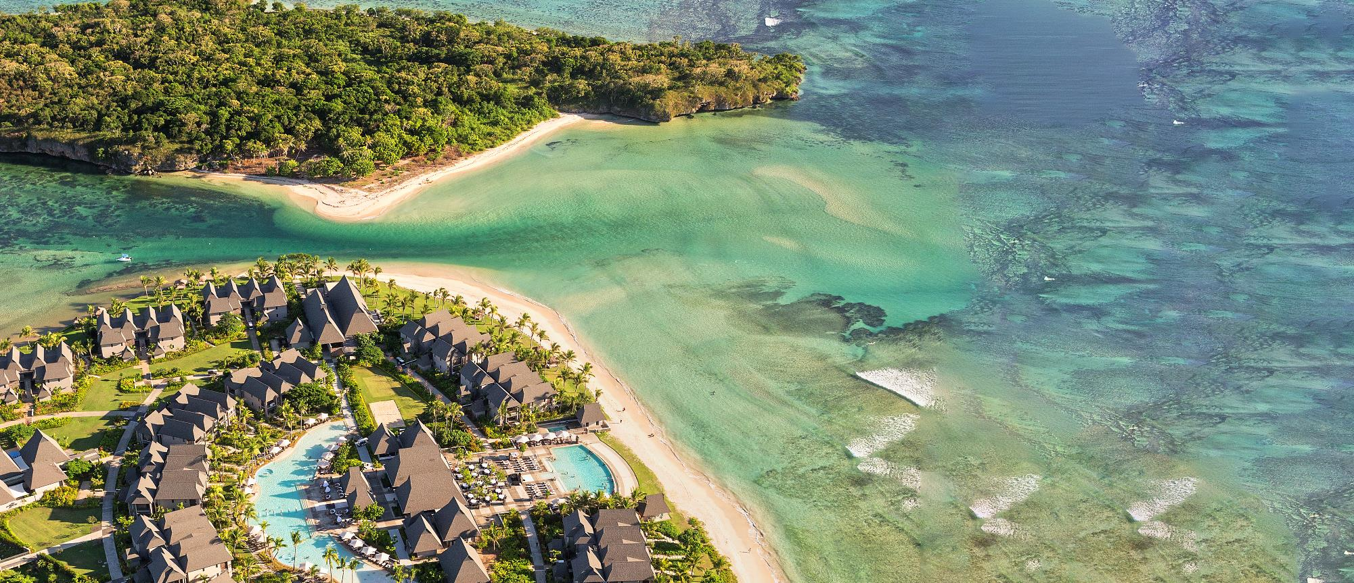
2022 Resort presentation
IHG®
InterContinental® Fiji Golf Resort & Spa Resort

Slide 2
IHG® Clean Promise
Good isn’t good enough – we’re committed to high levels of cleanliness. That means clean, well-maintained, clutter-free rooms that meet our standards. If this isn’t what you find when you check in then we promise to make it right.

Slide 3
AWARD-WINNING DESTINATION
Notes:
GUIDANCE
Hotel/events case study first page (Dark Grey):
Title text is 20pt, coloured IC Black (Dark Grey, Text 1)
The title side rules are 1.25pt thick, coloured IC Black (Dark Grey, Text 1) and aligned vertically to the text middle (centre)

Slide 4
RESORT LOCATION & ACCESS

Slide 5
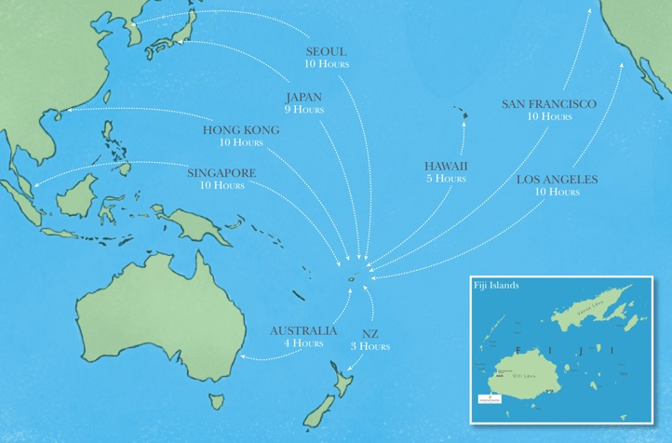
RESORT LOCATION & ACCESS
Fiji Islands Location
The resort is 45 minutes drive or 15 minute scenic helicopter ride from Nadi International Airport and is situated on the Western coast of the island of Viti Levu
InterContinental Fiji brings an outer island experience on one of the world’s best beaches as named by Forbes Magazine and CNN

Slide 6
RESORT LOCATION & ACCESS
Fiji Islands Map
The resort is 45 minutes drive or 15 minute scenic helicopter ride from Nadi International Airport and is situated on the Western coast of the island of Viti Levu
InterContinental Fiji brings an outer island experience on one of the worlds best beaches as named by Forbes Magazine and CNN

Slide 7
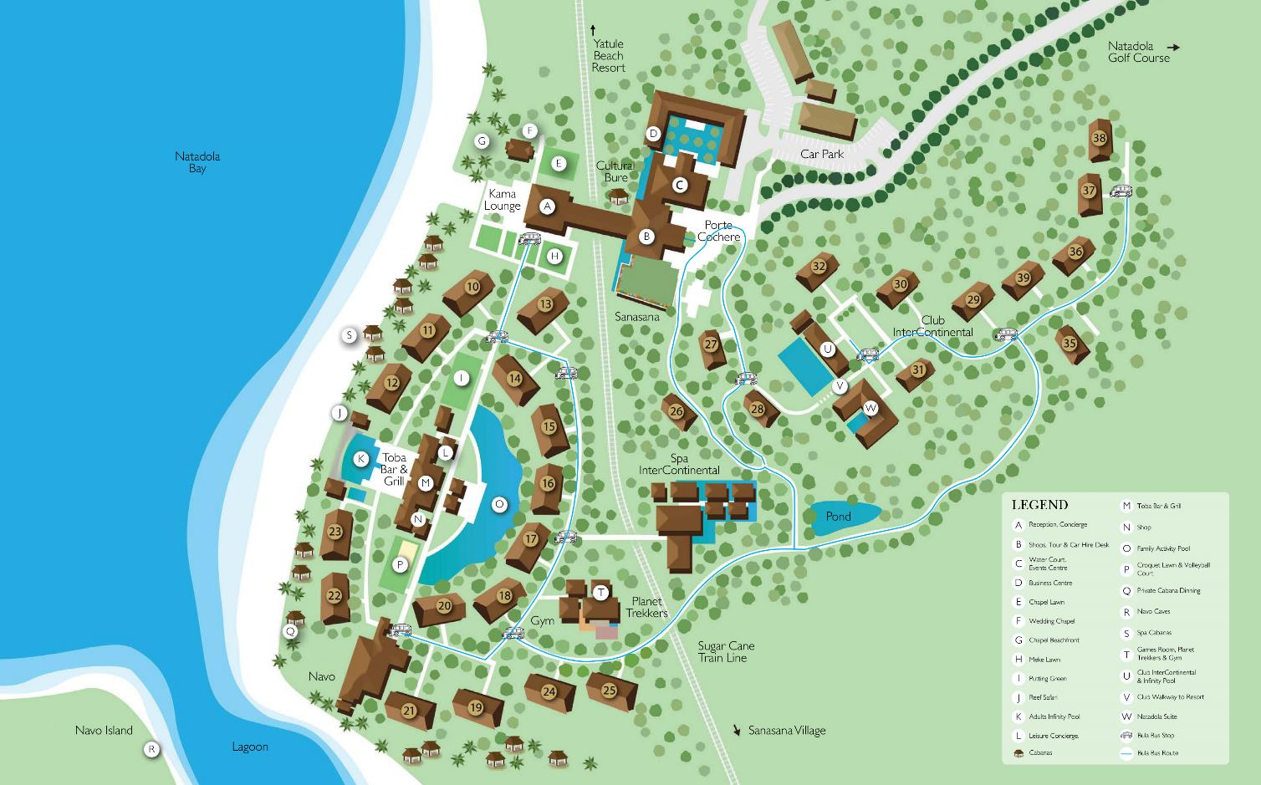
RESORT MAP
Notes:
GUIDANCE
Single image and text page:
Title text is 20pt, coloured IC Black (Dark Grey, Text 1)
The title text box is set to “resize shape to fit text”, and unticked “wrap text to shape” so that its White area automatically covers the portion of the title side rules.
The title side rules are 1.25pt thick, coloured in 100% IC Pink (Tan, Accent 1) and aligned vertically to the text middle (centre)
Body text is 100% Dark Grey and Pink
The short accent rule is 2pt thick, coloured in the palest tint of IC Pink (Tan, Accent 1, Lighter 80%)

Slide 8
OUR UNIQUE POINTS OF DIFFERENCES
Location
Isolated enough to be exclusive and private and not have the crowds that comp set have
Located on an award-winning beach (Natadola Beach voted Top 25 in the World by CNN and #1 Beach in Fiji by Forbes Magazine)
Beach setting allows for positioning of “offering an island experience on the Fijian mainland”
Shorter traveling time to Sigatoka-based activities and tours such as the Sigatoka River Safari and Zip Fiji. Also easy access to the nearby Momi Zipline
Accommodation - Club
Only “resort within a resort” concept accommodation in Fiji at the luxury level
Rates are semi-all-inclusive refer with unique benefits and amenities such as a daily replenishable mini-bar, private holiday planner, and butler service
Its own designated staff and facilities (restaurant, pool, etc)
Heightened privacy and exclusivity; resort guests have no access to the club and its facilities
Extremely spacious with plunge pools in ground floor suites
(starting at 115sqm)
Accommodation - Resort
Isolated enough to be exclusive and private and not have the crowds that comp set have
Located on an award-winning beach (Natadola Beach voted Top 25 in the World by CNN and #1 Beach in Fiji by Forbes Magazine)
Beach setting allows for positioning of “offering an island experience on the Fijian mainland”
Shorter travelling time to Sigatoka based activities and tours such as the Sigatoka River Safari and Zip Fiji. Also easy access to the nearby Momi Zipline.
Spa
Award winning spa recently recognised in the 2018 World Luxury Spa Awards as Best South Pacific/Oceania Luxury Resort Spa
Guest service delivery (escorted experience of the spa, full orientation of spa delivery etc)
Breathing experiences prior to each treatment for a holistic approach to relaxing and getting mind in place
Wai Zone – hydrotherapy room with hot tub, steam room and ice room
Orchid Room - treatment room offering a day bed experience, personal showers
Complimentary basic yoga and stretch lessons available
Notes:
GUIDANCE
Text page 2 column (Pink):
Title text is 20pt, coloured IC Black (Dark Grey, Text 1)
The title text box is set to “resize shape to fit text”, and unticked “wrap text to shape” so that its Pink area automatically covers the portion of the title side rules.
The title side rules are 1.25pt thick, coloured in the palest tint of IC Pink (Tan, Accent 1, Lighter 80%) and aligned vertically to the text middle (centre)
Body text is 100% Dark Grey and the palest tint of IC Pink (Tan, Accent 1, Lighter 80%)

Slide 9
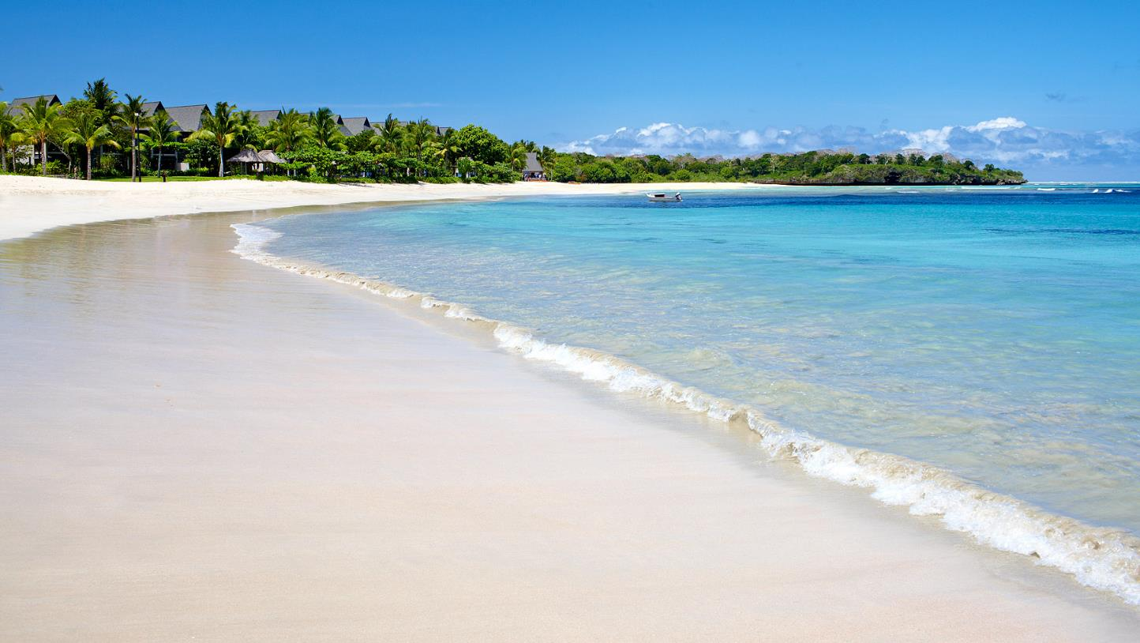
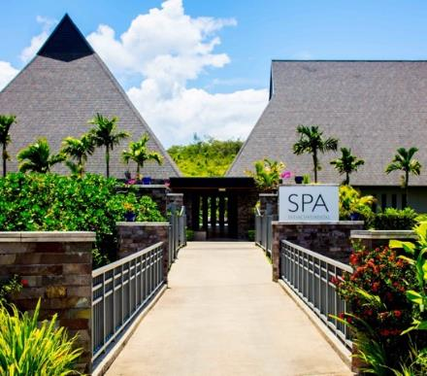
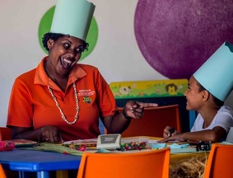
OUR UNIQUE POINTS OF DIFFERENCES
Spa Intercontinental
The only white sandy beach on the Fijian Mainland
Planet Trekkers Kids Club
Notes:
GUIDANCE
4 image page:
Title text is 20pt, coloured IC Black (Dark Grey, Text 1)
The title text box is set to “resize shape to fit text”, and unticked “wrap text to shape” so that its White area automatically covers the portion of the title side rules.
The title side rules are 1.25pt thick, coloured in 100% IC Pink (Tan, Accent 1) and aligned vertically to the text middle (centre)
Image caption text is 100% Dark Grey

Slide 10
OUR UNIQUE POINTS OF DIFFERENCES
Concierge
The only resort in Fiji with a dedicated concierge team True concierge services in line with the IHG brand. This is an important part of our services and guests are encouraged to connect with our team help turn their holiday dreams into a reality
The Concierge service plays and important part of any InterContinental brand and they help shape the experience of our guests.
Our concierge team have great contacts to take guests off the beaten track and provide personalized experience that brand resorts are not normally known for
Activities
A large cross section of land and ocean based activities including stand up paddle boards, surfing. Note that surfing is not an option for Denarau based properties.
Deep sea fishing – guests do not have to travel far as we have a reef near the resort
More accessible to adventure based activities based out of Sigatoka and surrounding area – Sigatoka River Safari, Zip Fiji, Kula Eco Park etc
Complimentary “learn to scuba” lesson
Authentic Fijian village activities such as Coconut Show, weaving, Fijian village visits, pottery shows, Fijian church visits, and more
Each guest enjoys 1 hour of non-motorized watersport activities per day as part of their rate inclusion
Restaurants & Dining
Leaders are internationally experienced and qualified:
Director Dining & Entertainment – Bjoern Noeldner (Germany)
Executive Chef – David Bell (Australia)
All restaurants have a view of the beach and ocean beyond
Bespoke dining experiences are available (Navo PDR, Dinner Under The Stars, and Cabana Dining)
Able to cater for all types of diets, allergies, and dietary requests (vegan, peanut allergies, gluten-free, paleo diet, etc)
Specially crafted children’s menu available at each restaurant
Bar team specially trained by Australian mixologist (Qunyh Nguyen) and offers a premium variety of cocktails
Extensive range of new and old world wines available at our different restaurants. Old world wines are exclusively offered at our signature restaurant, Navo
Navo Restaurant has been recognized as a recipient of the AON Fiji Excellence in Tourism Awards for its excellent dining experience
Notes:
GUIDANCE
Text page 2 column (Pink):
Title text is 20pt, coloured IC Black (Dark Grey, Text 1)
The title text box is set to “resize shape to fit text”, and unticked “wrap text to shape” so that its Pink area automatically covers the portion of the title side rules.
The title side rules are 1.25pt thick, coloured in the palest tint of IC Pink (Tan, Accent 1, Lighter 80%) and aligned vertically to the text middle (centre)
Body text is 100% Dark Grey and the palest tint of IC Pink (Tan, Accent 1, Lighter 80%)

Slide 11
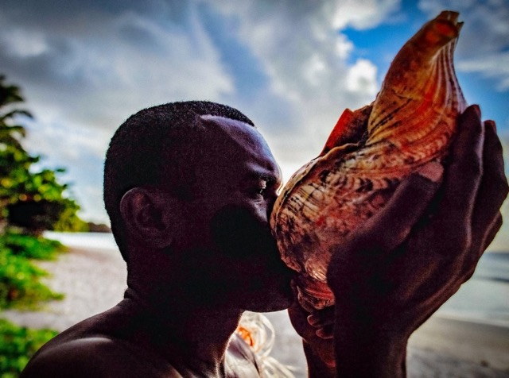
OUR UNIQUE POINTS OF DIFFERENCES
Personal Fijian Experiences
Whilst brand resorts are not normally known for personalized experiences, the InterContinental strives to offer authentic Fijian experiences in all aspects of our products and services. Examples are as follows:
Traditional Fijian foods included in the menu
Activities – refer to the activities section
Personalised meet and greet by name
History lessons, medicine walks
Incorporating more Fijian day-to-day living into guest experiences
Planet Trekkers Kids Club
The InterContinental Fiji Golf Resort & Spa offers two land transfer options:
Shared airport shuttle transfers
Luxury private Landcruiser transfers (seats 4 comfortably)
A bespoke helicopter transfer experience is also available and can be arranged with a premium helicopter service provider
Other than the above, we can also arrange for rental cars and taxis with our Tour Desk and Concierge Team
Notes:
GUIDANCE
Text page 2 column (Pink):
Title text is 20pt, coloured IC Black (Dark Grey, Text 1)
The title text box is set to “resize shape to fit text”, and unticked “wrap text to shape” so that its Pink area automatically covers the portion of the title side rules.
The title side rules are 1.25pt thick, coloured in the palest tint of IC Pink (Tan, Accent 1, Lighter 80%) and aligned vertically to the text middle (centre)
Body text is 100% Dark Grey and the palest tint of IC Pink (Tan, Accent 1, Lighter 80%)

Slide 12
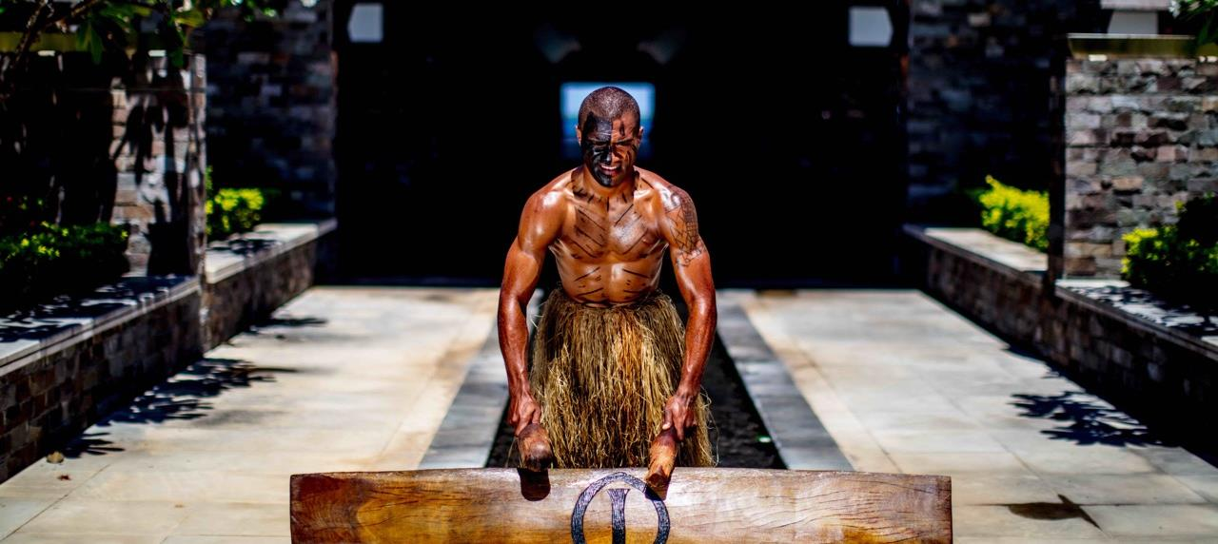
THE RESORT

Slide 13
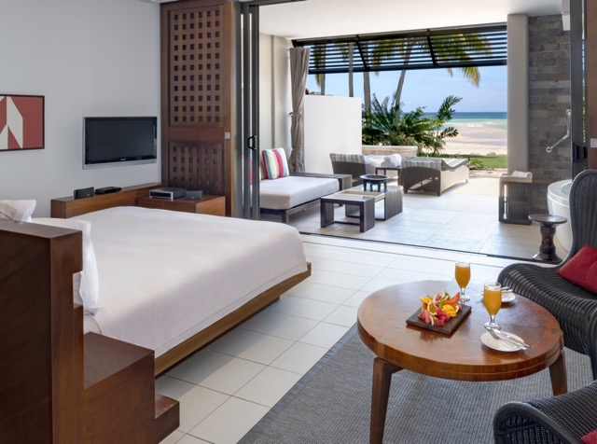
MAIN RESORT ACCOMMODATION
216 rooms in the main resort complex
Largest lead-in rooms from 63m²
Suite rooms are 85m²
Main Resort room categories:
Garden View King
Garden View Twin
Pool View King
Lagoon View King
Lagoon View Suite
Beachfront View King
Beachfront View Suite
Notes:
GUIDANCE
Text page 2 column (Pink):
Title text is 20pt, coloured IC Black (Dark Grey, Text 1)
The title text box is set to “resize shape to fit text”, and unticked “wrap text to shape” so that its Pink area automatically covers the portion of the title side rules.
The title side rules are 1.25pt thick, coloured in the palest tint of IC Pink (Tan, Accent 1, Lighter 80%) and aligned vertically to the text middle (centre)
Body text is 100% Dark Grey and the palest tint of IC Pink (Tan, Accent 1, Lighter 80%)

Slide 14
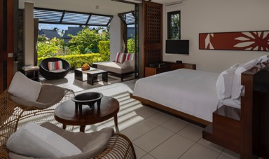
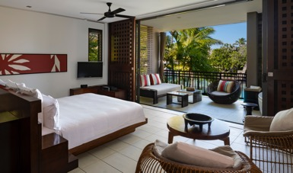
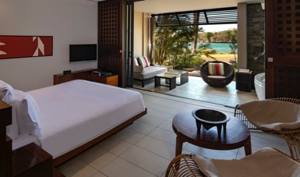
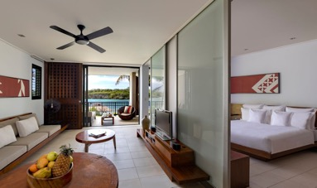
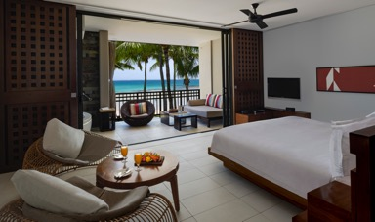
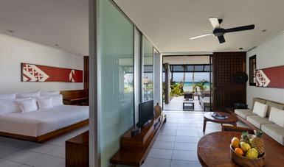
MAIN RESORT ACCOMMODATION
1 Garden View Room-Bottom Floor
1 Pool View Room-Top Floor
1 King Lagoon view-Bottom Floor
1 King Suite Lagoon View-Top Floor
1 King Bed Beachfront View
1 King Suite Beachfront View
Notes:
GUIDANCE
6 image page:
Title text is 20pt, coloured IC Black (Dark Grey, Text 1)
The title text box is set to “resize shape to fit text”, and unticked “wrap text to shape” so that its White area automatically covers the portion of the title side rules.
The title side rules are 1.25pt thick, coloured in 100% IC Pink (Tan, Accent 1) and aligned vertically to the text middle (centre)
Image caption text is 100% Dark Grey

Slide 15
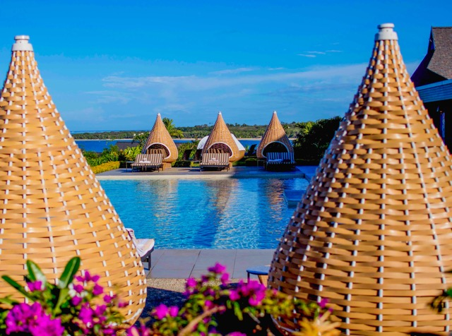
CLUB INTERCONTINENTAL®
Club InterContinental, set high on the hill with sweeping panoramic views of Natadola Bay, is a celebration of style where seasoned travelers are treated to an elevated standard of hospitality through luxurious all-suite accommodations and personalized services.
50 premium one and two-bedroom private suites where all ground floor suites feature a plunge pool
Access to the Club InterContinental Lounge facility and exclusive Club InterContinental privileges
Club InterContinental room categories:
One Bedroom Club Suite
One Bedroom Club Suite with plunge pool
Two Bedroom Club Suite
Two Bedroom Club Suite with plunge pool
Natadola Suite
Notes:
GUIDANCE
Text page 2 column (Pink):
Title text is 20pt, coloured IC Black (Dark Grey, Text 1)
The title text box is set to “resize shape to fit text”, and unticked “wrap text to shape” so that its Pink area automatically covers the portion of the title side rules.
The title side rules are 1.25pt thick, coloured in the palest tint of IC Pink (Tan, Accent 1, Lighter 80%) and aligned vertically to the text middle (centre)
Body text is 100% Dark Grey and the palest tint of IC Pink (Tan, Accent 1, Lighter 80%)

Slide 16
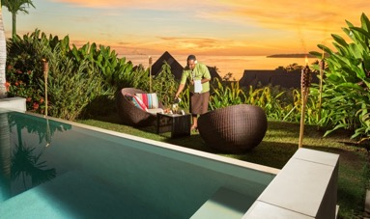
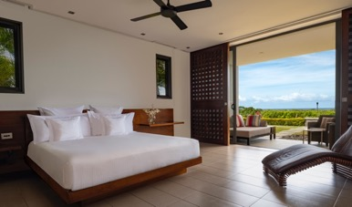
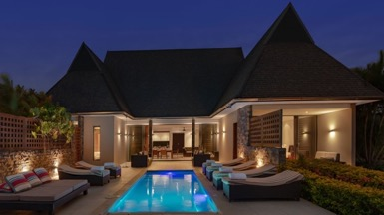
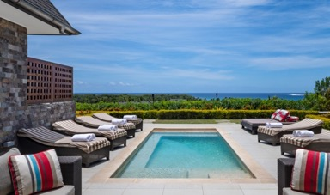
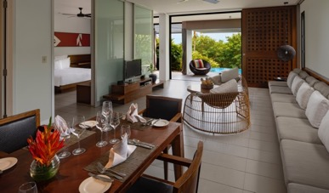
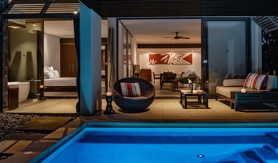
CLUB INTERCONTINENTAL
Itokani butler service
Natadola Suite
Natadola Suite Pool view
Natadola Suite Pool view
Club Plunge Room
Club Plunge Room-Evening Shot
Notes:
GUIDANCE
6 image page:
Title text is 20pt, coloured IC Black (Dark Grey, Text 1)
The title text box is set to “resize shape to fit text”, and unticked “wrap text to shape” so that its White area automatically covers the portion of the title side rules.
The title side rules are 1.25pt thick, coloured in 100% IC Pink (Tan, Accent 1) and aligned vertically to the text middle (centre)
Image caption text is 100% Dark Grey

Slide 17
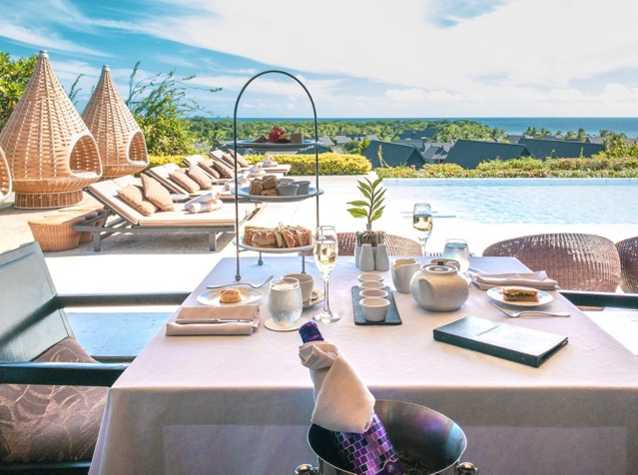
CLUB INTERCONTINENTAL® PRIVILEGES
Private check-in and check-out
itokani butler service
Access to the Club InterContinental Lounge and infinity pool
Breakfast in a choice of 3 venues:
A la Carte at the Club InterContinental Lounge
Full buffet breakfast at Sanasana Restaurant
Intimate Breakfast at Navo (adults only)
All day non-alcoholic drinks in the Club InterContinental Lounge
Afternoon tea in the Club InterContinental Lounge
Sunset canapés and cocktails for two hours each evening in the Club InterContinental Lounge
Complimentary daily replenishable non alcoholic mini-bar
Fresh South Pacific fruits upon arrival
Wake up energizing juice with your selection of freshly picked fruits and/or pastries in the Club InterContinental Lounge
Complimentary wireless internet access throughout the resort
Daily turndown service
Notes:
GUIDANCE
Text page 2 column (Pink):
Title text is 20pt, coloured IC Black (Dark Grey, Text 1)
The title text box is set to “resize shape to fit text”, and unticked “wrap text to shape” so that its Pink area automatically covers the portion of the title side rules.
The title side rules are 1.25pt thick, coloured in the palest tint of IC Pink (Tan, Accent 1, Lighter 80%) and aligned vertically to the text middle (centre)
Body text is 100% Dark Grey and the palest tint of IC Pink (Tan, Accent 1, Lighter 80%)

Slide 18
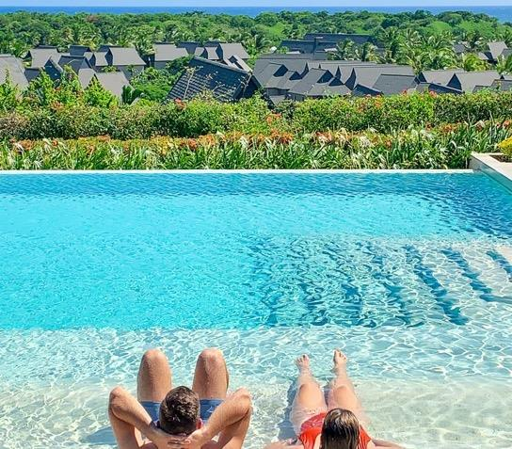
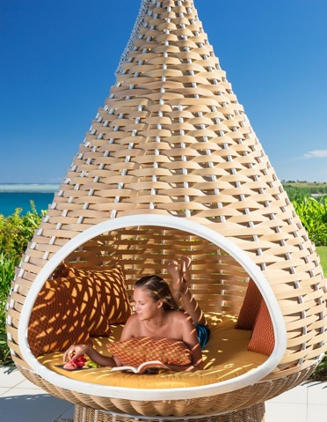
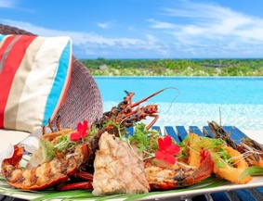
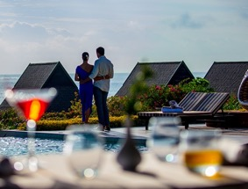
CLUB INTERCONTINENTAL® PRIVILEGES
Private Club Restaurant
Club Lounge Pool
Club Lounge Love Pods
Complimentary Cocktails
Notes:
GUIDANCE
4 image page:
Title text is 20pt, coloured IC Black (Dark Grey, Text 1)
The title text box is set to “resize shape to fit text”, and unticked “wrap text to shape” so that its White area automatically covers the portion of the title side rules.
The title side rules are 1.25pt thick, coloured in 100% IC Pink (Tan, Accent 1) and aligned vertically to the text middle (centre)
Image caption text is 100% Dark Grey

Slide 19
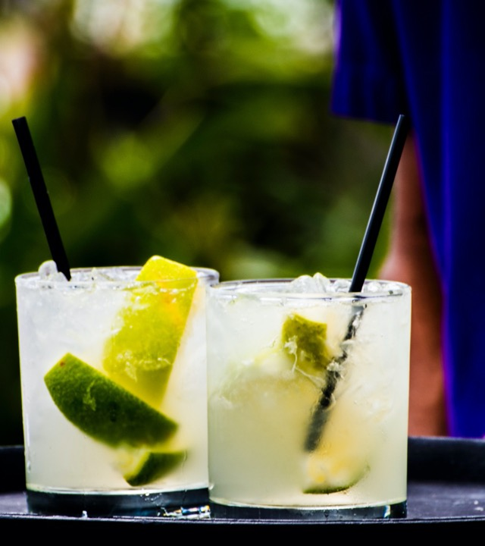
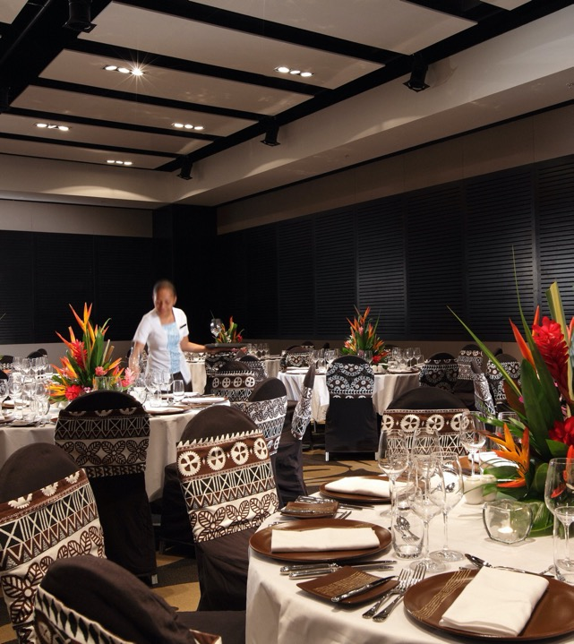
FOOD & BEVERAGE
InterContinental®
19
Notes:
GUIDANCE
Pink divider slide:
Title text is 22pt, coloured IC Black (Dark Grey, Text 1)
The short accent rule is 2pt thick, coloured in the palest tint of IC Pink (Tan, Accent 1, Lighter 80%)

Slide 20
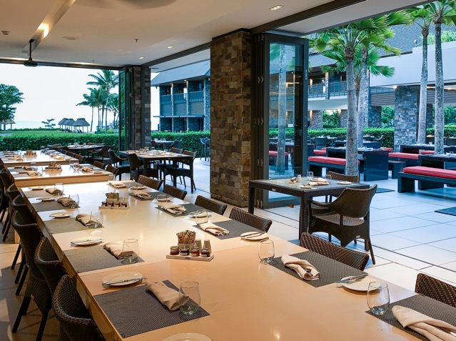
DINING & BESPOKE EXPERIENCES
Sanasana Restaurant
Overlooking the Meke lawn and Natadola Bay, Sanasana offers buffet style breakfast, à la carte lunch and themed buffet dinner, delivering a different theme each evening.
Notes:
GUIDANCE
Single image and text page:
Title text is 20pt, coloured IC Black (Dark Grey, Text 1)
The title text box is set to “resize shape to fit text”, and unticked “wrap text to shape” so that its White area automatically covers the portion of the title side rules.
The title side rules are 1.25pt thick, coloured in 100% IC Pink (Tan, Accent 1) and aligned vertically to the text middle (centre)
Body text is 100% Dark Grey and Pink
The short accent rule is 2pt thick, coloured in the palest tint of IC Pink (Tan, Accent 1, Lighter 80%)

Slide 21
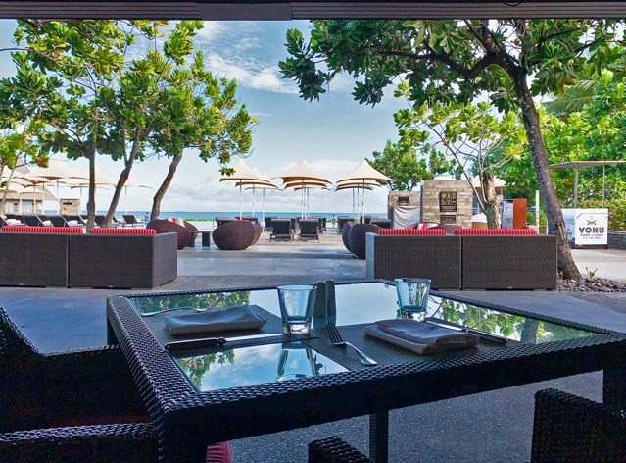
DINING & BESPOKE EXPERIENCES
Toba Bar & Grill
At the heart of the resort, enjoy casual Fiji dining at Toba Bar & Grill. The grill features a selection of dining options including wood-fired pizza, classic burgers and grilled items and desserts. Cocktails are available for poolside relaxing whilst overlooking the picturesque infinity pool and Natadola Bay.
Notes:
GUIDANCE
Single image and text page:
Title text is 20pt, coloured IC Black (Dark Grey, Text 1)
The title text box is set to “resize shape to fit text”, and unticked “wrap text to shape” so that its White area automatically covers the portion of the title side rules.
The title side rules are 1.25pt thick, coloured in 100% IC Pink (Tan, Accent 1) and aligned vertically to the text middle (centre)
Body text is 100% Dark Grey and Pink
The short accent rule is 2pt thick, coloured in the palest tint of IC Pink (Tan, Accent 1, Lighter 80%)

Slide 22
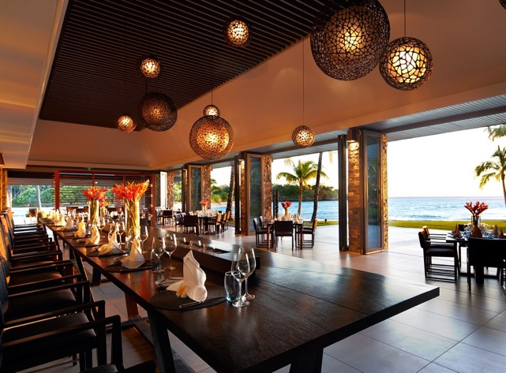
DINING & BESPOKE EXPERIENCES
Navo Restaurant
Offering guests refined specialty dining, Navo restaurant overlooks Natadola Bay and Navo island. This specialty dining restaurant features contemporary cuisine inspired by the ocean and an extensive range of international wines. Featuring a glass-enclosed show kitchen rated as one of the best restaurants in Fiji.
Notes:
GUIDANCE
Single image and text page:
Title text is 20pt, coloured IC Black (Dark Grey, Text 1)
The title text box is set to “resize shape to fit text”, and unticked “wrap text to shape” so that its White area automatically covers the portion of the title side rules.
The title side rules are 1.25pt thick, coloured in 100% IC Pink (Tan, Accent 1) and aligned vertically to the text middle (centre)
Body text is 100% Dark Grey and Pink
The short accent rule is 2pt thick, coloured in the palest tint of IC Pink (Tan, Accent 1, Lighter 80%)

Slide 23
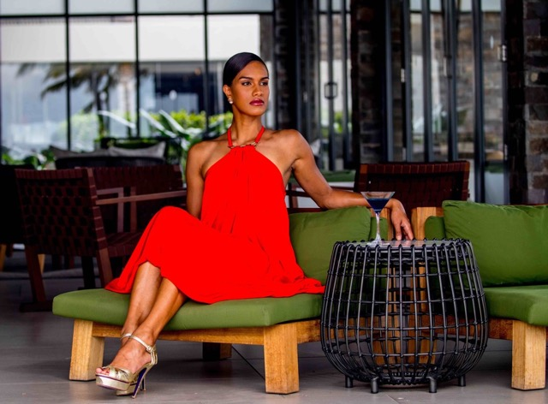
Single image and text page
Kama Lounge
Overlooking the white sands of Natadola Bay and the azure ocean, Kama Lounge is the ideal place to absorb the atmosphere, relax and enjoy the sunset over the Pacific Ocean. Specializing in international and locally inspired cocktails, light meals, and a passionate team dedicated to delivering enticing cocktails.
Notes:
GUIDANCE
Single image and text page:
Title text is 20pt, coloured IC Black (Dark Grey, Text 1)
The title text box is set to “resize shape to fit text”, and unticked “wrap text to shape” so that its White area automatically covers the portion of the title side rules.
The title side rules are 1.25pt thick, coloured in 100% IC Pink (Tan, Accent 1) and aligned vertically to the text middle (centre)
Body text is 100% Dark Grey and Pink
The short accent rule is 2pt thick, coloured in the palest tint of IC Pink (Tan, Accent 1, Lighter 80%)

Slide 24
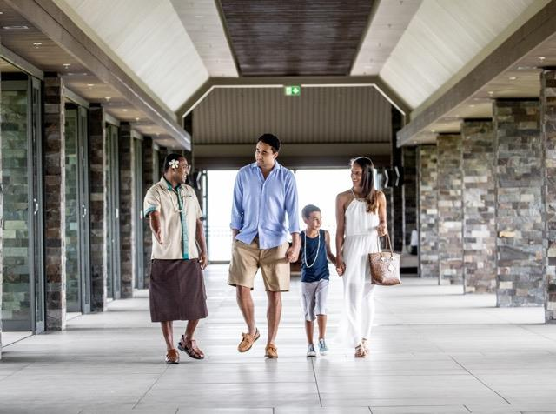
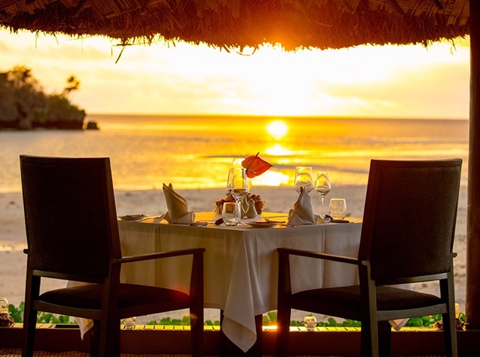
DINING & BESPOKE EXPERIENCES
Bespoke Dining
InterContinental Fiji Golf Resort & Spa offers the perfect way to celebrate that special occasion:
Private beachside cabana dining
Dinner Under the Stars
Navo Restaurant private dining room
Notes:
GUIDANCE
Single image and text page:
Title text is 20pt, coloured IC Black (Dark Grey, Text 1)
The title text box is set to “resize shape to fit text”, and unticked “wrap text to shape” so that its White area automatically covers the portion of the title side rules.
The title side rules are 1.25pt thick, coloured in 100% IC Pink (Tan, Accent 1) and aligned vertically to the text middle (centre)
Body text is 100% Dark Grey and Pink
The short accent rule is 2pt thick, coloured in the palest tint of IC Pink (Tan, Accent 1, Lighter 80%)

Slide 25
Meetings & Events
InterContinental®
25
Notes:
GUIDANCE
Pink divider slide:
Title text is 22pt, coloured IC Black (Dark Grey, Text 1)
The short accent rule is 2pt thick, coloured in the palest tint of IC Pink (Tan, Accent 1, Lighter 80%)

Slide 26
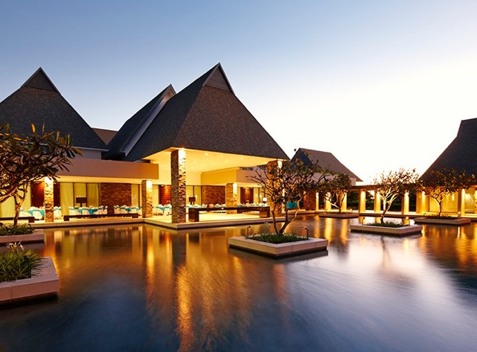
INTERCONTINENTAL® MEETINGS & World of weddings
Our world-class Watercourt conference center offers 11 air-conditioned event rooms, including a pillarless ballroom (579m²) which can comfortably seat 600 people. Hidden from the main resort, the Watercourt area offers maximum privacy for events whilst conveniently located in the main resort complex.
We also have insider locations we recommend to provide delegates with a unique insight into Fiji such as our unique beachfront or the 4th hole at our golf course for authentic and memorable interaction.
Also on offer are various outdoor locations for the perfect destination wedding – from beach alternatives to a dedicated wedding pavilion that can be air-conditioned or opened up for the natural sea breeze.
Our experienced team will be ‘at your side’ to not only make an event a great one but one that guests will never forget.
Notes:
GUIDANCE
Text page 2 column (Pink):
Title text is 20pt, coloured IC Black (Dark Grey, Text 1)
The title text box is set to “resize shape to fit text”, and unticked “wrap text to shape” so that its Pink area automatically covers the portion of the title side rules.
The title side rules are 1.25pt thick, coloured in the palest tint of IC Pink (Tan, Accent 1, Lighter 80%) and aligned vertically to the text middle (centre)
Body text is 100% Dark Grey and the palest tint of IC Pink (Tan, Accent 1, Lighter 80%)

Slide 27
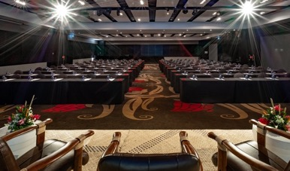
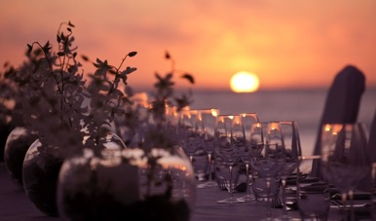
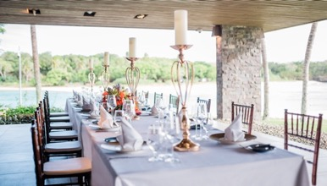
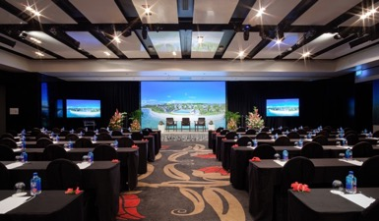
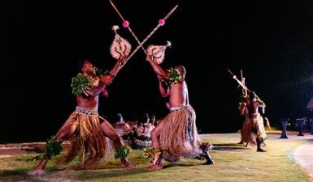
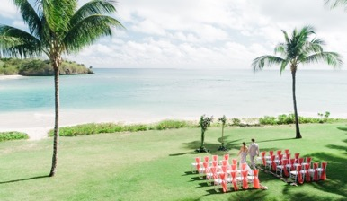
INTERCONTINENTAL® MEETINGS & World of weddings
Notes:
GUIDANCE
6 image page:
Title text is 20pt, coloured IC Black (Dark Grey, Text 1)
The title text box is set to “resize shape to fit text”, and unticked “wrap text to shape” so that its White area automatically covers the portion of the title side rules.
The title side rules are 1.25pt thick, coloured in 100% IC Pink (Tan, Accent 1) and aligned vertically to the text middle (centre)
Image caption text is 100% Dark Grey

Slide 28
MEETING ROOMS CAPACITY
 | BOARDROOM | U-SHAPE | HOLLOW SQUARE | CLASSROOM | BANQUET | THEATRE | CABARET | SIZE (SQM) | L X W (M) | HEIGHT (M)
Boardroom | 12 | - | - | - | - | - | - | 30.24 | 7.2 x 4.2 | 2.4
Natadola 1 | 44 | 50 | 44 | 84 | 130 | 190 | 72 | 200 | 20 x 10 | 3.5
Natadola 1 & 2 | 100 | 90 | 100 | 192 | 288 | 390 | 104 | 420 | 20 x 21 | 3.5
Natadola 2 | 44 | 50 | 44 | 84 | 130 | 190 | 72 | 210 | 20 x 10.5 | 3.5
Natadola 2 & 3 | 100 | 90 | 100 | 192 | 288 | 390 | 104 | 420 | 20 x 21 | 3.5
Natadola Ballroom | 132 | 90 | 132 | 280 | 450 | 600 | 18 | 576 | 32 x 18 | 3.5
Watercourt 1 | 15 | 18 | 15 | 18 | 224 | 40 | 18 | 56 | 7 x 8 | 3
Notes:
GUIDANCE
6 image page:
Title text is 20pt, coloured IC Black (Dark Grey, Text 1)
The title text box is set to “resize shape to fit text”, and unticked “wrap text to shape” so that its White area automatically covers the portion of the title side rules.
The title side rules are 1.25pt thick, coloured in 100% IC Pink (Tan, Accent 1) and aligned vertically to the text middle (centre)
Image caption text is 100% Dark Grey

Slide 29
MEETING ROOMS CAPACITY
 | BOARDROOM | U-SHAPE | HOLLOW SQUARE | CLASSROOM | BANQUET | THEATRE | CABARET | SIZE (SQM) | L X W (M) | HEIGHT (M)
Watercourt 3 | 22 | 24 | 22 | 25 | 32 | 50 | 30 | 72 | 9 x 8 | 3
Watercourt 5 | 22 | 24 | 22 | 25 | 32 | 50 | 30 | 72 | 9 x 8 | 3
Watercourt 1 & 2 | 32 | 42 | 32 | 40 | 64 | 96 | 48 | 120.96 | 16.8 x 7.2 | 3
Watercourt 3 & 4 | 36 | 52 | 36 | 66 | 80 | 110 | 60 | 151.2 | 16.8 x 9 | 3
Watercourt 5 & 6 | 36 | 52 | 36 | 66 | 80 | 110 | 60 | 151.2 | 16.8 x 9 | 3
Notes:
GUIDANCE
6 image page:
Title text is 20pt, coloured IC Black (Dark Grey, Text 1)
The title text box is set to “resize shape to fit text”, and unticked “wrap text to shape” so that its White area automatically covers the portion of the title side rules.
The title side rules are 1.25pt thick, coloured in 100% IC Pink (Tan, Accent 1) and aligned vertically to the text middle (centre)
Image caption text is 100% Dark Grey

Slide 30
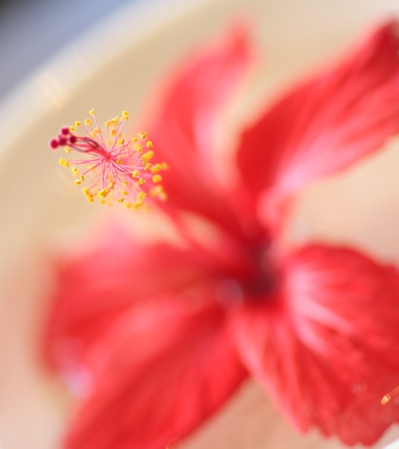
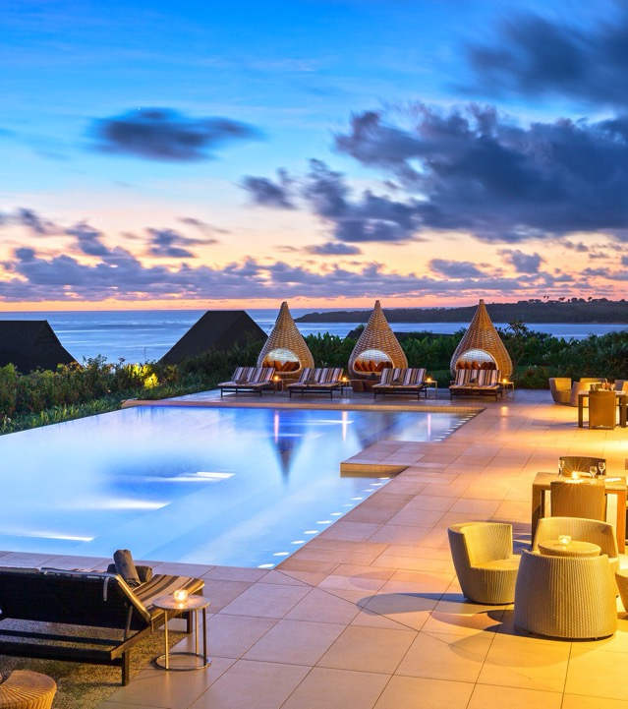
SPA & WELLNESS
Spa InterContinental®
30
Notes:
GUIDANCE
Pink divider slide:
Title text is 22pt, coloured IC Black (Dark Grey, Text 1)
The short accent rule is 2pt thick, coloured in the palest tint of IC Pink (Tan, Accent 1, Lighter 80%)

Slide 31
DINING & BESPOKE EXPERIENCES
SPA INTERCONTINENTAL®
A haven of peace and relaxation, the award-winning Spa InterContinental is the perfect getaway. Combining Asian, Eastern, and Western treatment methods to bring balance to mind, body, and soul, our spa experiences offer the best of Fiji’s environment and hospitality.
Featuring:
5 single treatment rooms
4 couples’ treatment rooms
Hydrotherapy area ‘Wai’ zone
Notes:
GUIDANCE
Single image and text page:
Title text is 20pt, coloured IC Black (Dark Grey, Text 1)
The title text box is set to “resize shape to fit text”, and unticked “wrap text to shape” so that its White area automatically covers the portion of the title side rules.
The title side rules are 1.25pt thick, coloured in 100% IC Pink (Tan, Accent 1) and aligned vertically to the text middle (centre)
Body text is 100% Dark Grey and Pink
The short accent rule is 2pt thick, coloured in the palest tint of IC Pink (Tan, Accent 1, Lighter 80%)

Slide 32
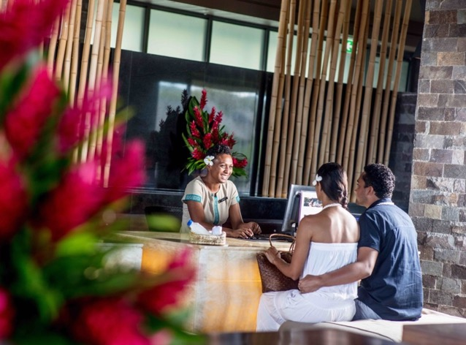
DINING & BESPOKE EXPERIENCES
INTERCONTINENTAL® AMBASSADOR LOYALTY PROGRAMME
A unique recognition programme for guests of InterContinental Hotels & Resorts.
Ambassador offers you a full range of first-class services and exclusive benefits to enhance any Ambassador member’s stay.
Notes:
GUIDANCE
Single image and text page:
Title text is 20pt, coloured IC Black (Dark Grey, Text 1)
The title text box is set to “resize shape to fit text”, and unticked “wrap text to shape” so that its White area automatically covers the portion of the title side rules.
The title side rules are 1.25pt thick, coloured in 100% IC Pink (Tan, Accent 1) and aligned vertically to the text middle (centre)
Body text is 100% Dark Grey and Pink
The short accent rule is 2pt thick, coloured in the palest tint of IC Pink (Tan, Accent 1, Lighter 80%)

Slide 33
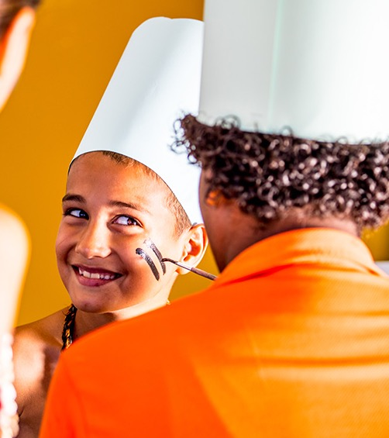
RECREATION
InterContinental®
33
Notes:
GUIDANCE
Pink divider slide:
Title text is 22pt, coloured IC Black (Dark Grey, Text 1)
The short accent rule is 2pt thick, coloured in the palest tint of IC Pink (Tan, Accent 1, Lighter 80%)

Slide 34
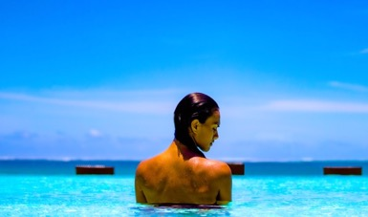
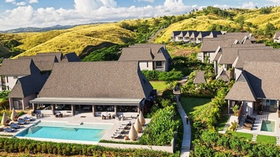
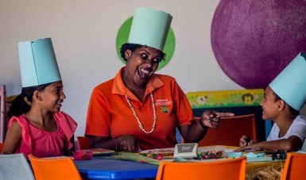
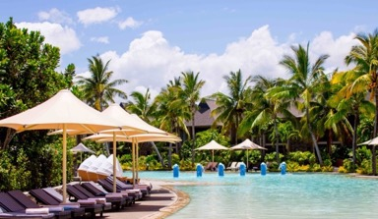
RESORT FACILITIES
Infinity Pool
Club InterContinental®, Lounge and Pools
Planet Trekkers Kids Club
Family Pool
Spa InterContinental®
Fitness Centre
Notes:
GUIDANCE
6 image page:
Title text is 20pt, coloured IC Black (Dark Grey, Text 1)
The title text box is set to “resize shape to fit text”, and unticked “wrap text to shape” so that its White area automatically covers the portion of the title side rules.
The title side rules are 1.25pt thick, coloured in 100% IC Pink (Tan, Accent 1) and aligned vertically to the text middle (centre)
Image caption text is 100% Dark Grey

Slide 35
INTERCONTINENTAL® CONCIERGE
Our InterContinental® Concierge offers personalized service and tailored itineraries focused on providing an “In The Know” local insight for a bespoke Fijian experience and unique insights into Fiji’s rich culture and history.
Notes:
GUIDANCE
Single image and text page:
Title text is 20pt, coloured IC Black (Dark Grey, Text 1)
The title text box is set to “resize shape to fit text”, and unticked “wrap text to shape” so that its White area automatically covers the portion of the title side rules.
The title side rules are 1.25pt thick, coloured in 100% IC Pink (Tan, Accent 1) and aligned vertically to the text middle (centre)
Body text is 100% Dark Grey and Pink
The short accent rule is 2pt thick, coloured in the palest tint of IC Pink (Tan, Accent 1, Lighter 80%)

Slide 36
LUXURY COMMERCIAL PARTNERS
We are partnered with selective luxury resort partners including Virtuoso, Signature Travel Network, Ensemble, American Express Hotel Collection and Select Hotels & Resorts for our premium positioning
Notes:
GUIDANCE
Single image and text page:
Title text is 20pt, coloured IC Black (Dark Grey, Text 1)
The title text box is set to “resize shape to fit text”, and unticked “wrap text to shape” so that its White area automatically covers the portion of the title side rules.
The title side rules are 1.25pt thick, coloured in 100% IC Pink (Tan, Accent 1) and aligned vertically to the text middle (centre)
Body text is 100% Dark Grey and Pink
The short accent rule is 2pt thick, coloured in the palest tint of IC Pink (Tan, Accent 1, Lighter 80%)

Slide 37
AWARDS
InterContinental®
Notes:
GUIDANCE
Pink divider slide:
Title text is 22pt, coloured IC Black (Dark Grey, Text 1)
The short accent rule is 2pt thick, coloured in the palest tint of IC Pink (Tan, Accent 1, Lighter 80%)

Slide 38
2019 RESORT AWARDS & NOMINATIONS
January 2019 – Trip Advisor Traveller’s Choice Awards: Top 25 Hotels in South Pacific (ranked #24)
January 2019 – Trip Advisor Traveller’s Choice Awards: Top 25 Beaches in South Pacific (ranked #22)
January 2019 – Trip Advisor Traveller’s Choice Awards: Top 10 Hotels in Fiji (ranked #4)
January 2019 – Trip Advisor Traveller’s Choice Awards: Top 10 Luxury Hotels in Fiji (ranked #7)
February 2019 – ANZ Fiji Excellence in Tourism Awards 2018 Nominations: Accommodation Luxury
February 2019 – ANZ Fiji Excellence in Tourism Awards 2018 Nominations: Visitor Dining Experience
February 2019 – ANZ Fiji Excellence in Tourism Awards 2018 Nominations: Fiji Pride Champion
March 2019 – World Luxury Hotel Awards Nomination
March 2019 – World Luxury Spa Awards Nomination
March 2019 – World Travel Awards Nominations: Oceania’s Leading Family Resort
March 2019 – World Travel Awards Nominations: Oceania’s Leading Resort
March 2019 – World Travel Awards Nominations: Fiji’s Leading Resort

